Slide 1
Smart Sentence Generator
Navkar Shah (60003160055)
Bhavi Modi (60003178007)
Yash Adke (60003178012)
Project Guides: Dr. Abhijit Joshi
Prof. Lakshmi Kurup

Slide 2
Introduction
The Smart Sentence Generator and Validator is supposed to be a support system for helping the students to learn sentence formation and other aspects of English language.
Our system aims at providing the students with a way to learn sentence formation, punctuation marks, and using correct grammar in the sentences.
It makes use of a template-based structure and NLP based libraries for generating sentences.

Slide 3
Motivation
English as a language has been proved to be difficult for the students to master.
The development of a system that can be used for teaching the students requires a perfect accuracy rate and completeness of the sentence.
There are currently no existing systems that can help the students through the learning process of the language.
The currently existing systems do not have accuracy rates even close to what can be suitable for purpose of teaching.

Slide 4
Objective
We are proposing a system that generates sentences with more accuracy than the existing systems.
We will provide input keywords to the system and the system generates a meaningful and correct sentence on its own using the data set we will make.
This proves to be helpful for students to learn on their own and at their own pace.

Slide 5
Problem Definition
In today’s fast paced and internet ruled word, there is still no system to generate syntactical English sentences.
Already available web apps only correct the given statements or point out errors.
None of the systems are able to generate sentences on its own. Even if the sentences are generated, they are incomplete in most cases.
We provide input keywords to the system and the system will generate a meaningful and correct sentence on its own using the data set we will make.

Slide 6
Scope
The system generates a list of sentences that contain the keywords given by user and those sentences would be syntactically as well as semantically correct.
The output sentences vary from simple to complex in nature.
The sentences contain the basic structure of a sentence that is easy to read.

Slide 7
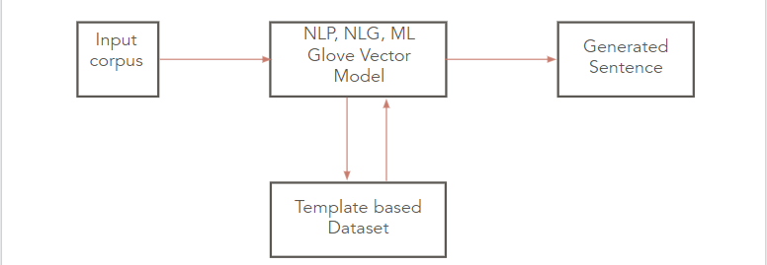

Input Parameters and Expected Output
Input Parameters : The keywords for sentence generation or sentence for validation.
Database : Self designed templates for providing relationships between the input keywords.
Expected Output : Semantically and Syntactically correct sentence generated.

Slide 8
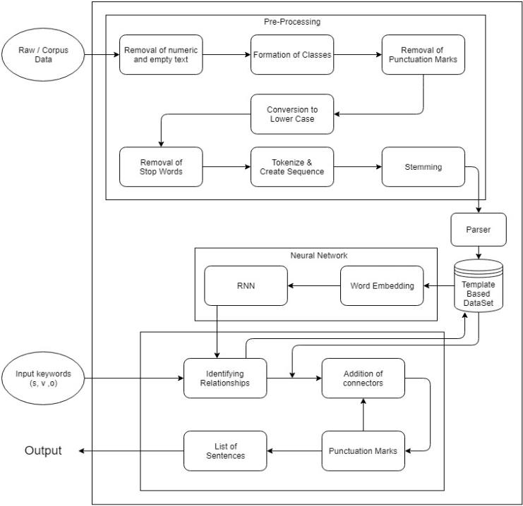
System Architecture

Slide 9
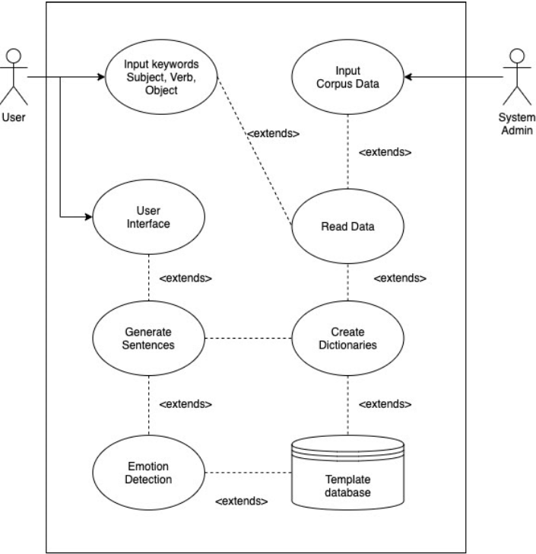
Use Case Diagram

Slide 10
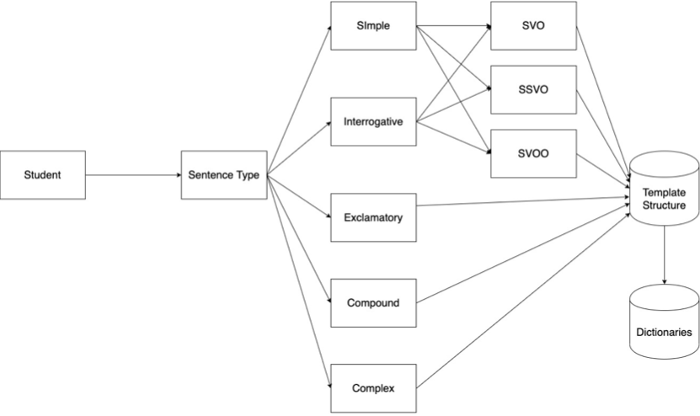
Activity Diagram

Slide 11
Benefits of the System
The main benefit of our system is that it serves as a great help to students in the early grades where they are learning about sentences.
The generated sentences by the students will be analyzed for grammar and punctuations by the validator.
It may be possible that sometimes the student has anxiety issues or the student is scared to ask a teacher about a doubt or correction.

Slide 12
Feasibility Study
Technical Feasibility:
RAM of system should be greater than 8gb.
Economic feasibility:
As all this is a digital process. This savea the cost of the use of paper and is a gesture towards saving the environment.
Operational Feasibility:
Our proposed system generates sentences with better efficiency than the existing systems.
The system completely automates the teaching process for lower grade students who are learning to write or create sentences.

Slide 13
Thank You

